Slide 1

DC vs Marvel
By: Alex, Anna, Kamran, Kevin, Nathan and Reed

Slide 2
Contents
01. Nathan
02. Kamran
Total Characters
Genders in each universe
Eye color in each universe
LGBTQ+ representation in each universe
Most appearance in each universe
Hair
04. Anna
Ratio of Hero to Villain
Who is the most powerful by alignment
03. Alex
Wealthiest character overall
Wealthiest by character type
Number and percentage of income source
06. Kevin
05. Reed
Which cinematic universe is more “successful”
Relations of hero/villain birthplaces
Birthplaces for both marvel and DC
Notes:
Nathan, Kamran, Alex Anna, Reed, Kevin

Slide 3

Nate:
Total Characters
Most appearances in each universe
Genders in each universe
Eye color in each universe
LGBTQ+ representation in each universe
Notes:
Here is an overview of the topics I will be discussing

Slide 4
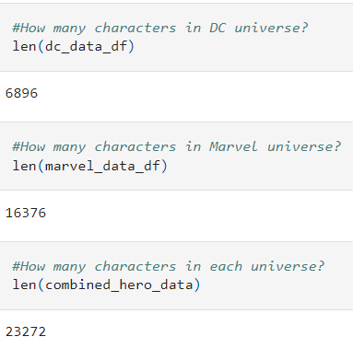
Total Characters in the DC and Marvel Universe
Notes:
Nate - First, we wanted to get an understanding of how many characters have appeared in each universe

Slide 5
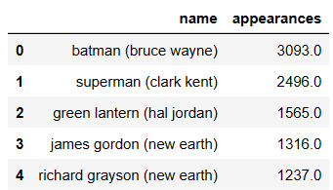
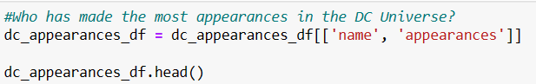
Most Appearances in the DC Universe
Notes:
Nate - Then we wanted to see who has made the most appearances. We thought this would be a good analysis of who are the most popular characters

Slide 6
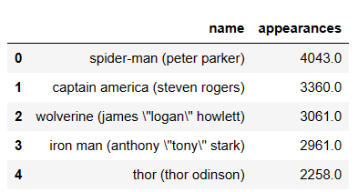
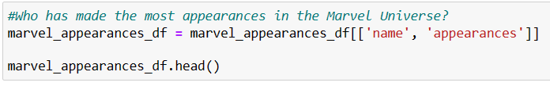
Most Appearances in the Marvel Universe
Notes:
Nate

Slide 7
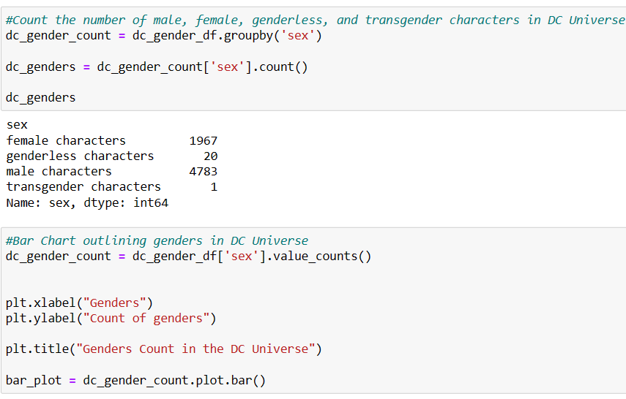
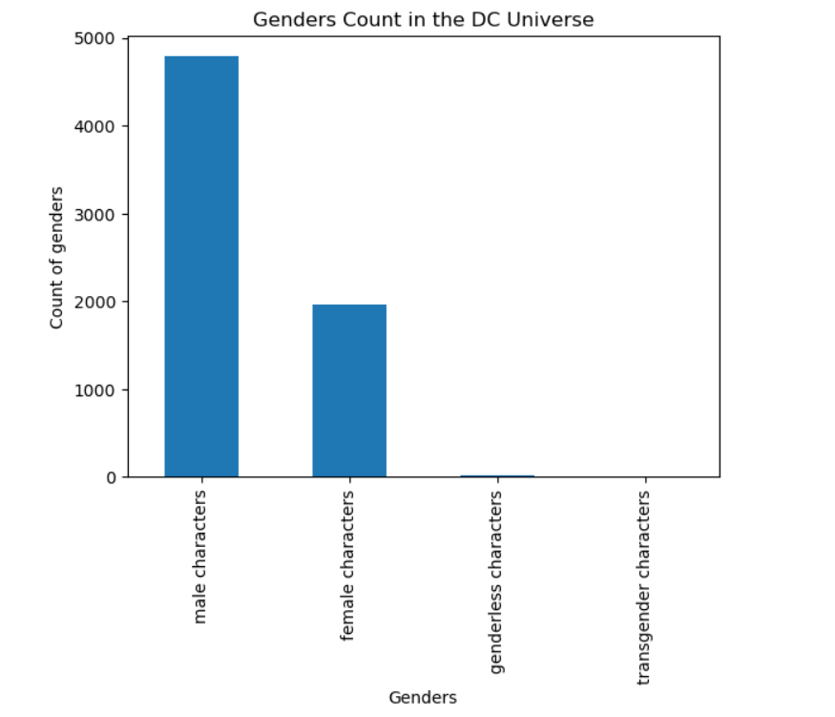
Gender Count in the DC Universe
Notes:
Nate

Slide 8
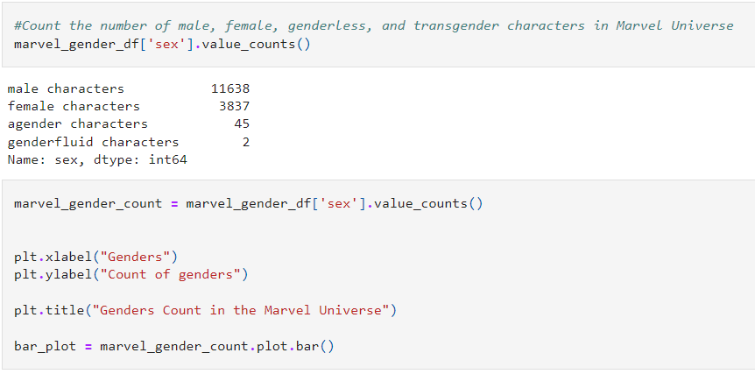
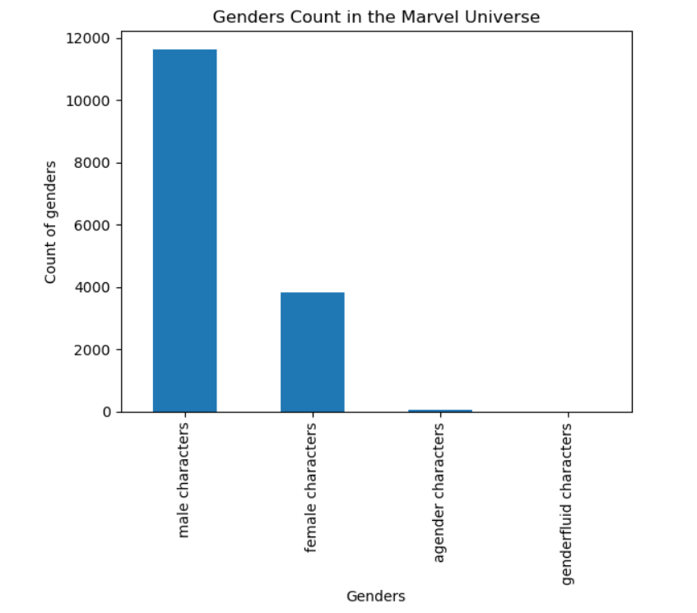
Gender Count in the Marvel Universe
Notes:
Nate

Slide 9
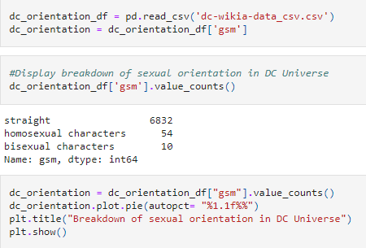
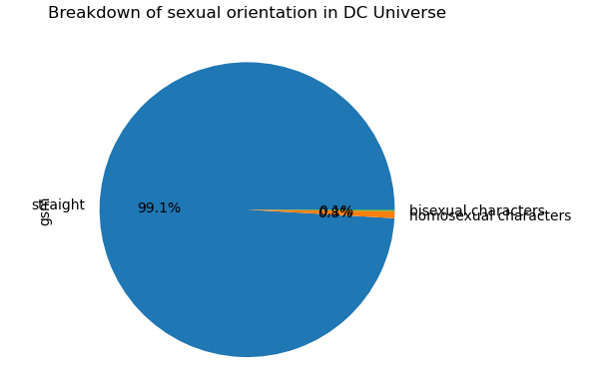
LGBTQ+ Representation in the DC Universe
Notes:
Nate

Slide 10
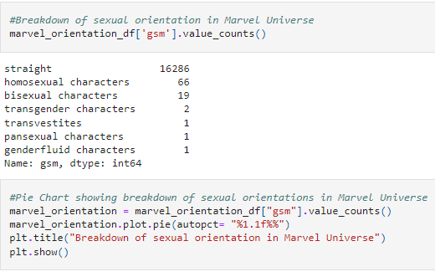
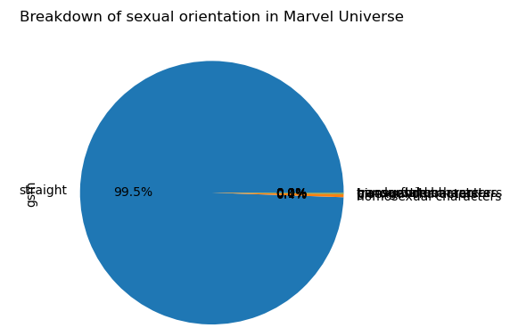
LGBTQ+ Representation in the Marvel Universe
Notes:
Nate

Slide 11
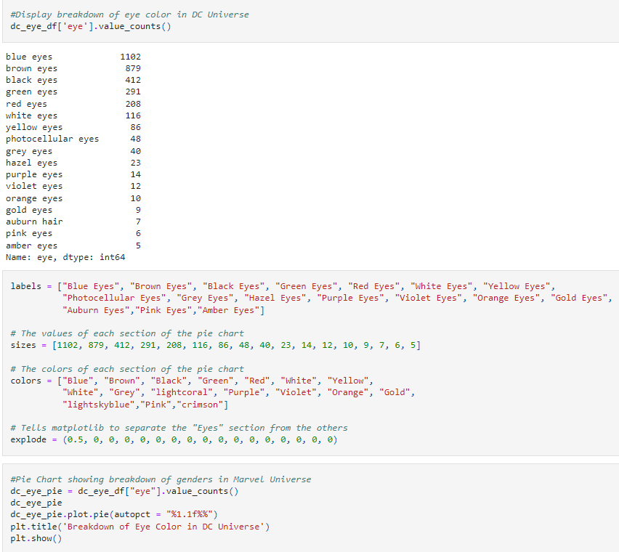
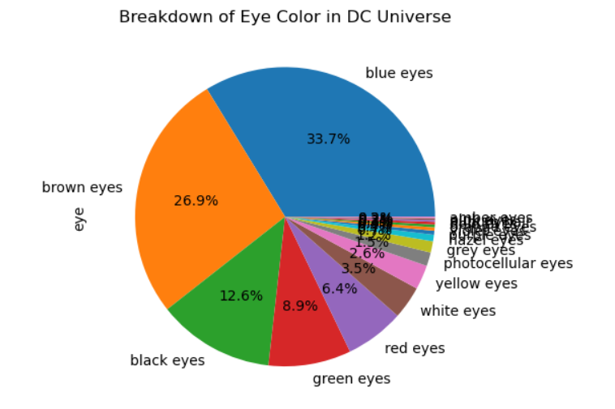
Eye Colors in the DC Universe
Notes:
Nate

Slide 12
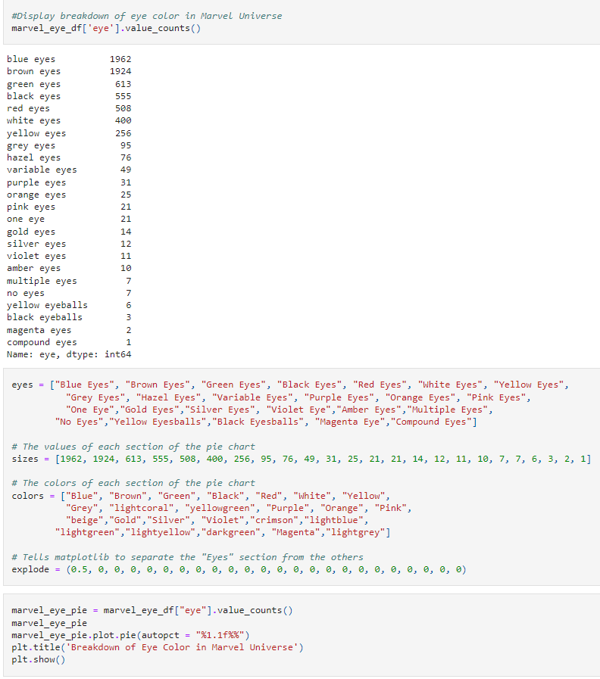
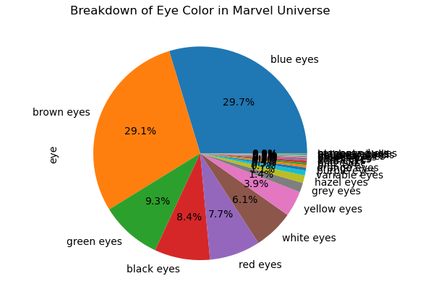
Eye Colors in the Marvel Universe
Notes:
Nate

Slide 13
Kamran:
Hair color

Slide 14
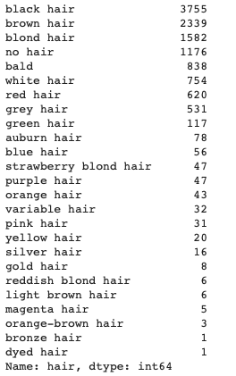
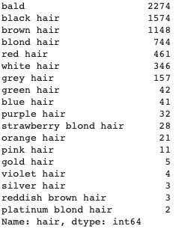
Marvel Hair Colors
DC Hair Colors

Slide 15
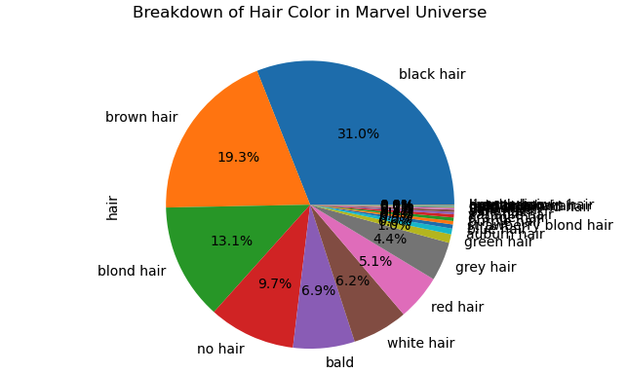
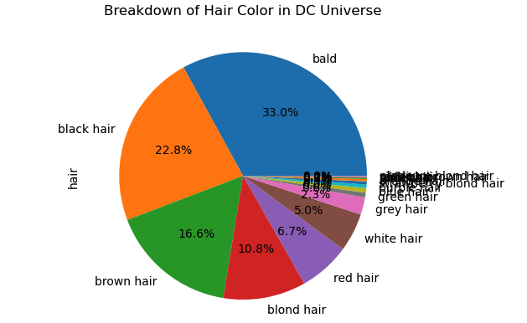

Slide 16
Alex:
Who is the wealthiest hero and Villain?

Slide 17
Alex:
List showing overall character wealth
Lists showing wealth by heroes and villains
Bar chart for number of characters per income source
Pie chart for percentages of income source
Notes:
Nate

Slide 18
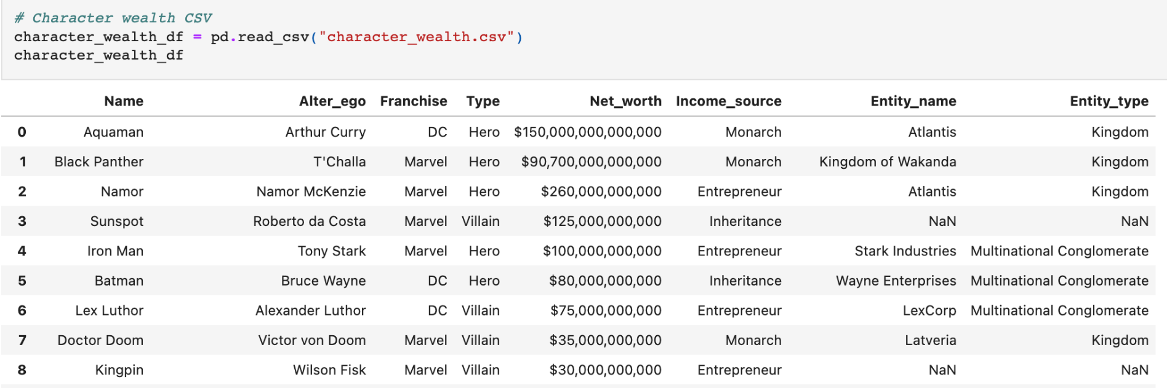
CSV File Organization

Slide 19
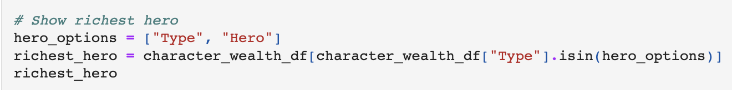
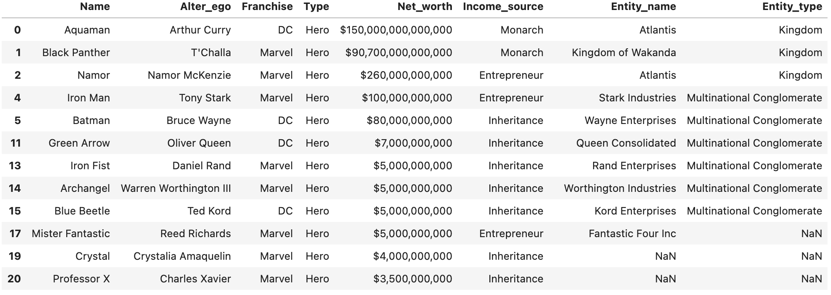
Heroes Wealth

Slide 20
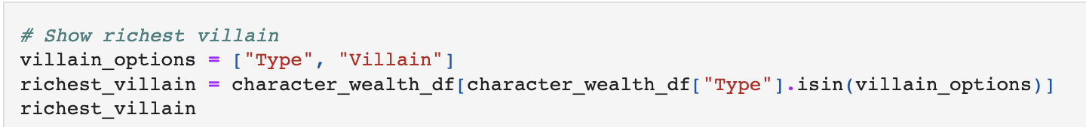
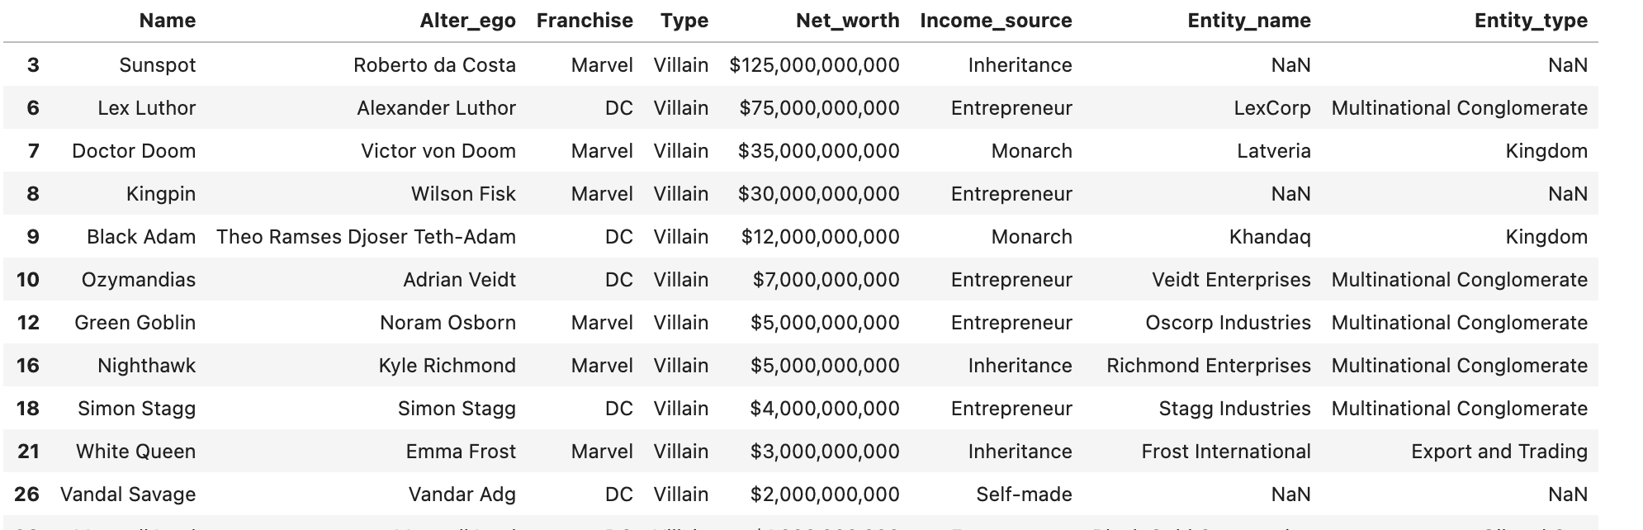
Villains Wealth

Slide 21
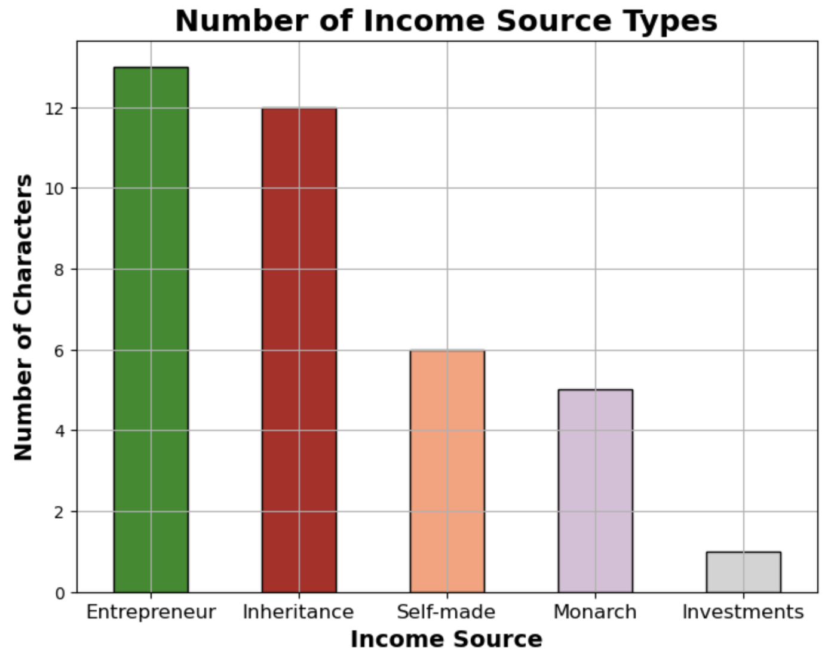
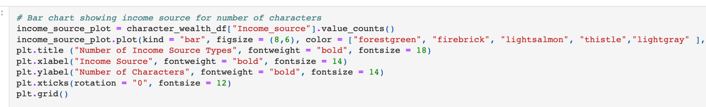
Bar Chart for Income Source

Slide 22
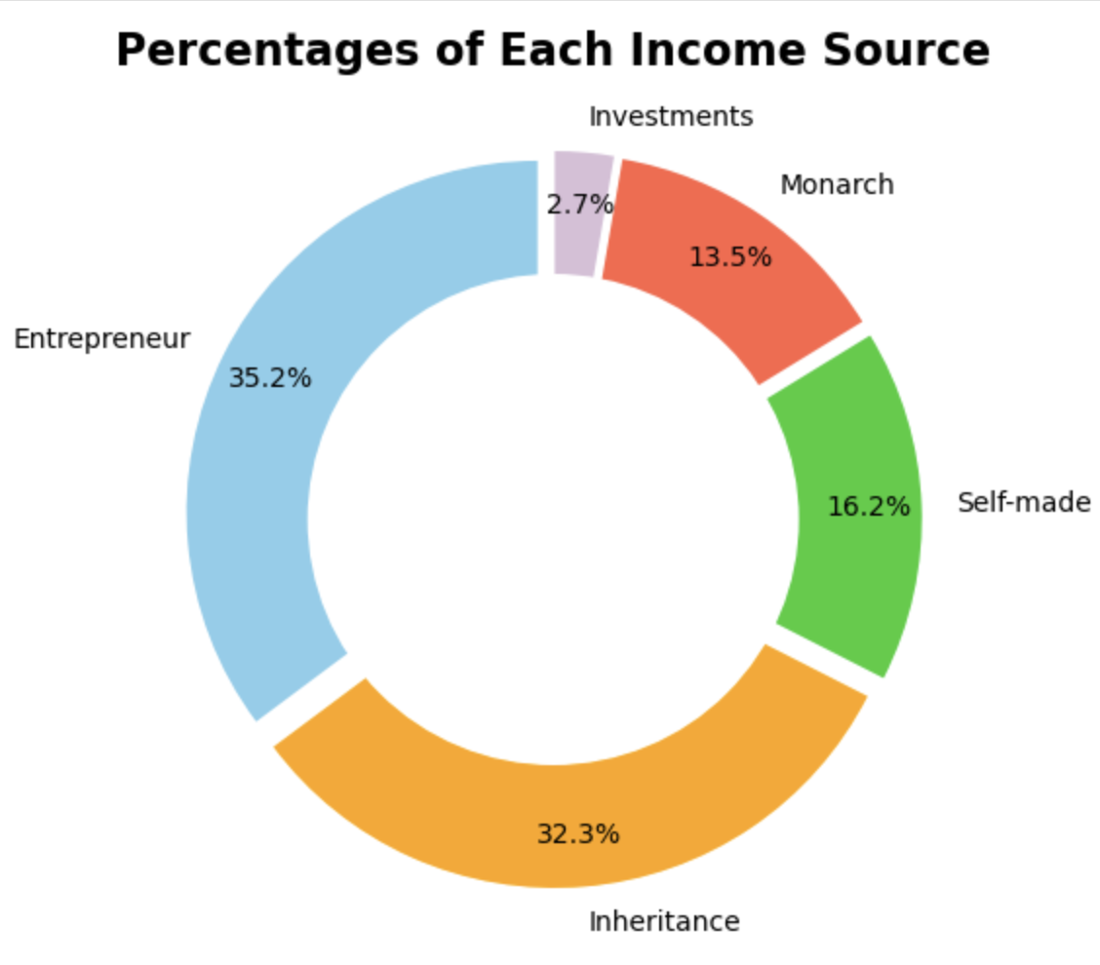
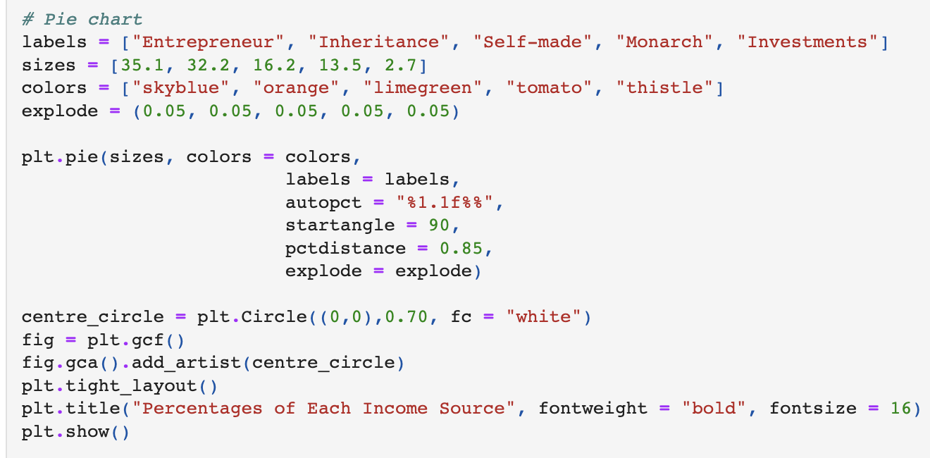
Pie Chart for Income Source

Slide 23
Anna: Strength of
Heros and Villain

Slide 24

Ratio
of Hero vs Villain

Slide 25

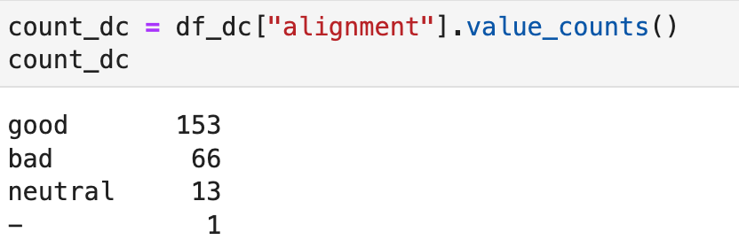
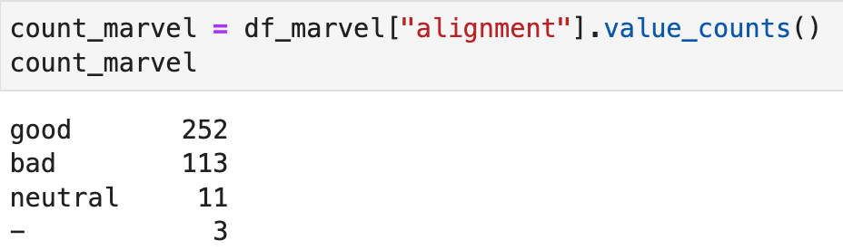
How many Marvel characters align good vs bad
How many DC characters align good vs bad

Slide 26
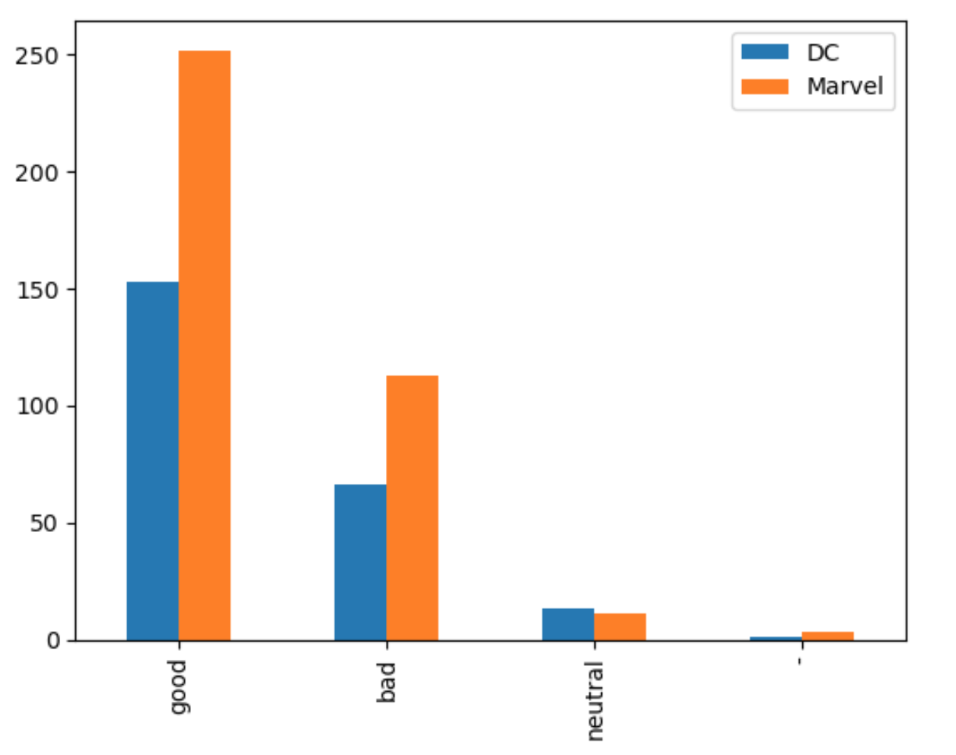
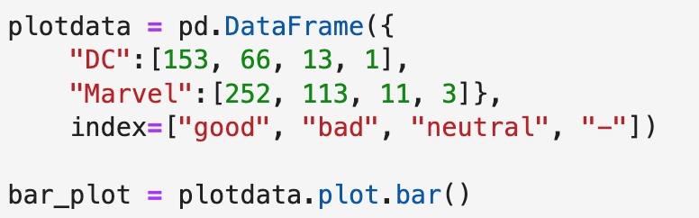
DC Count
Marvel Count

Slide 27
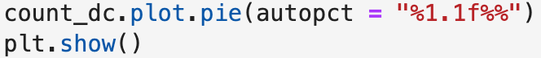
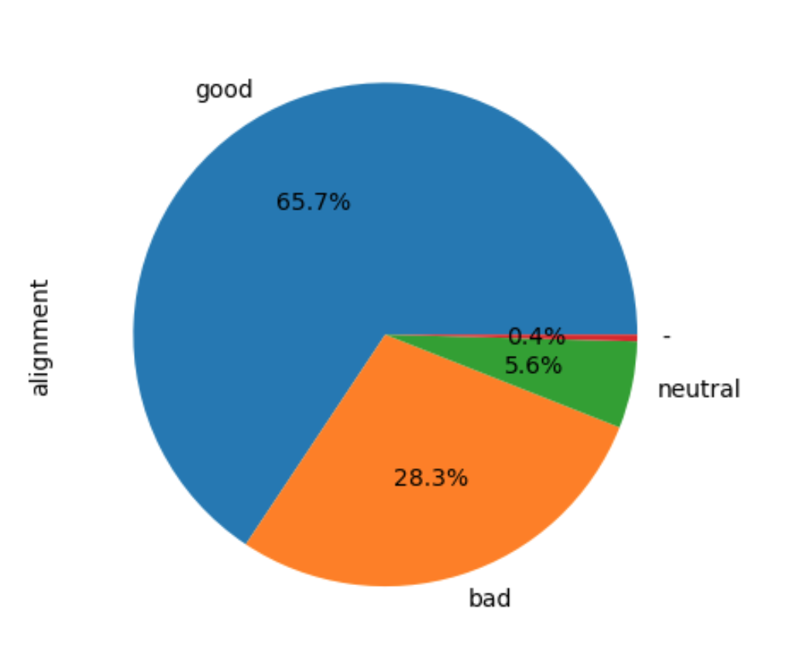
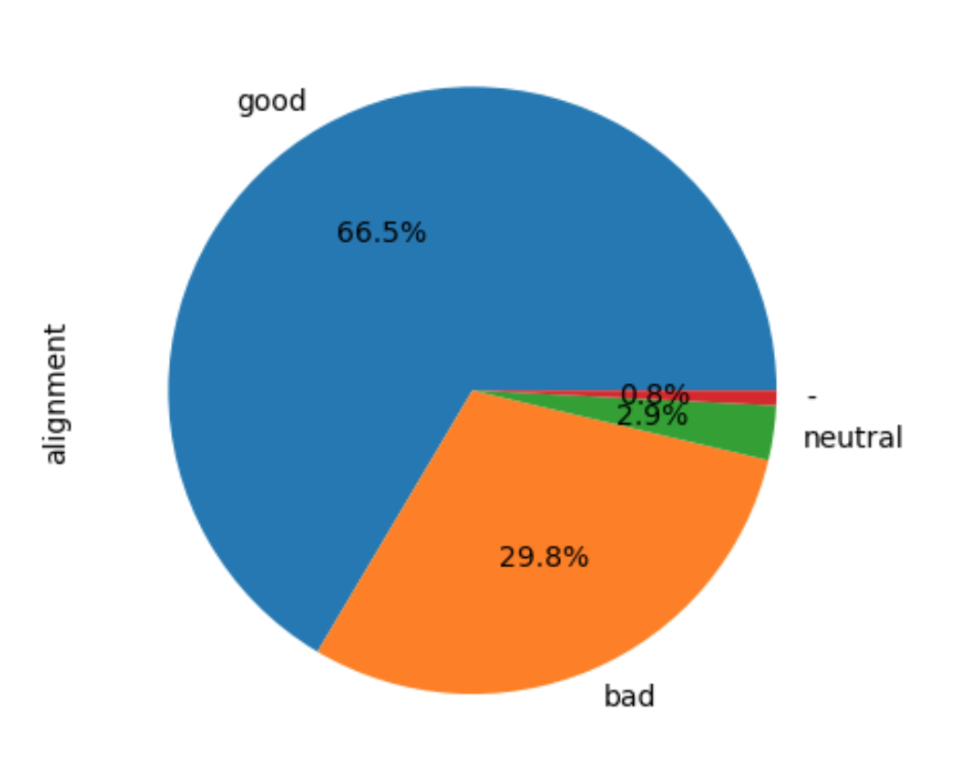
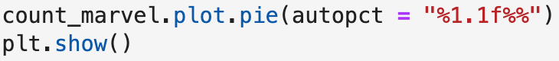
% of Marvel characters are good vs bad
% of DC characters are good vs bad

Slide 28
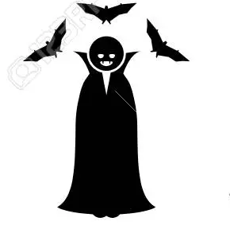
Power level
of Hero vs Villain

Slide 29
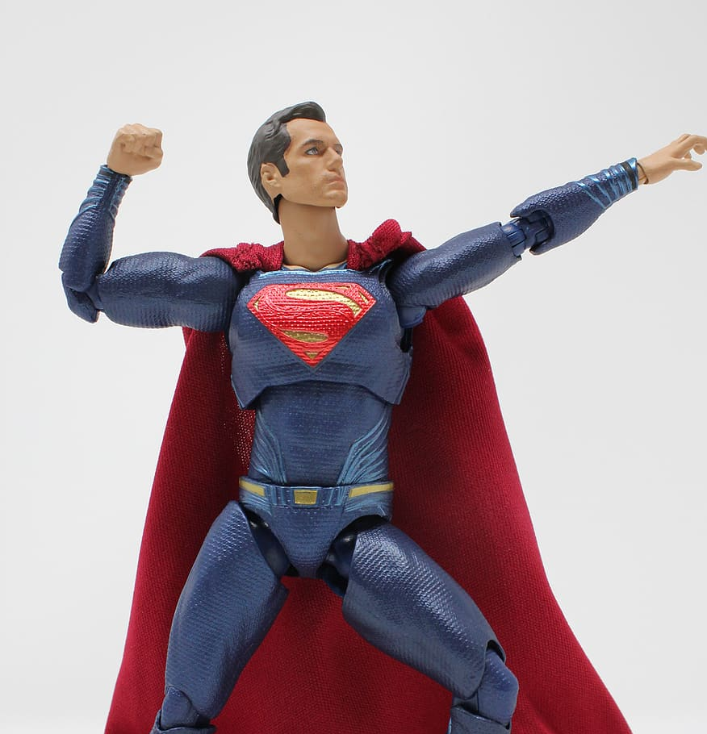
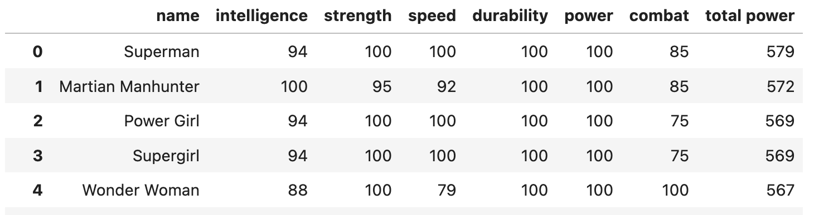
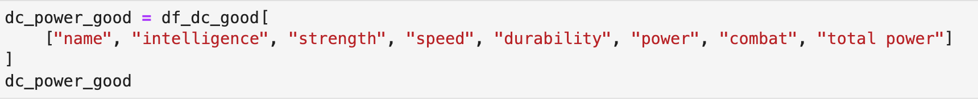
Most Powerful Hero (DC)

Slide 30
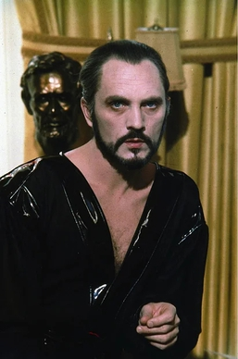
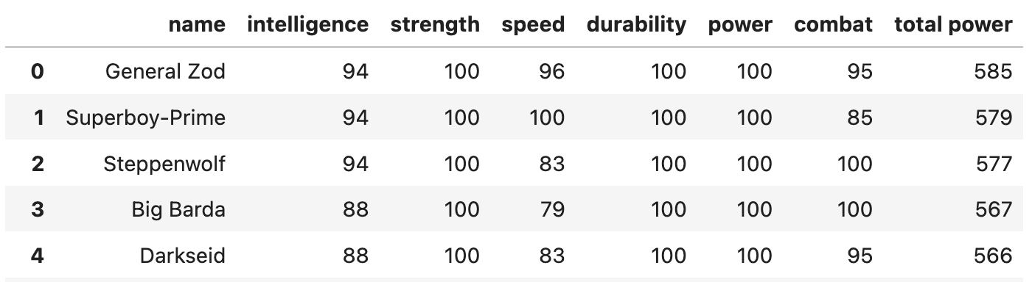
Most Powerful Villain (DC)

Slide 31
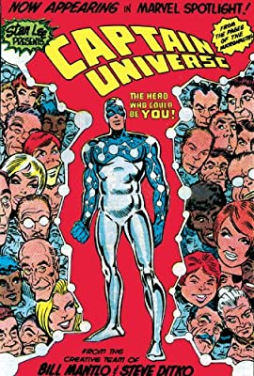
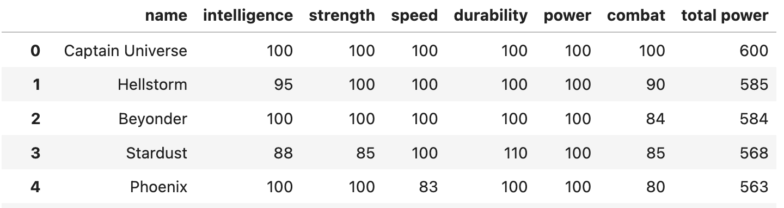
Most Powerful Hero (Marvel)

Slide 32
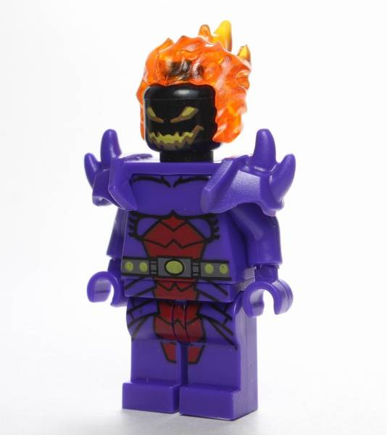
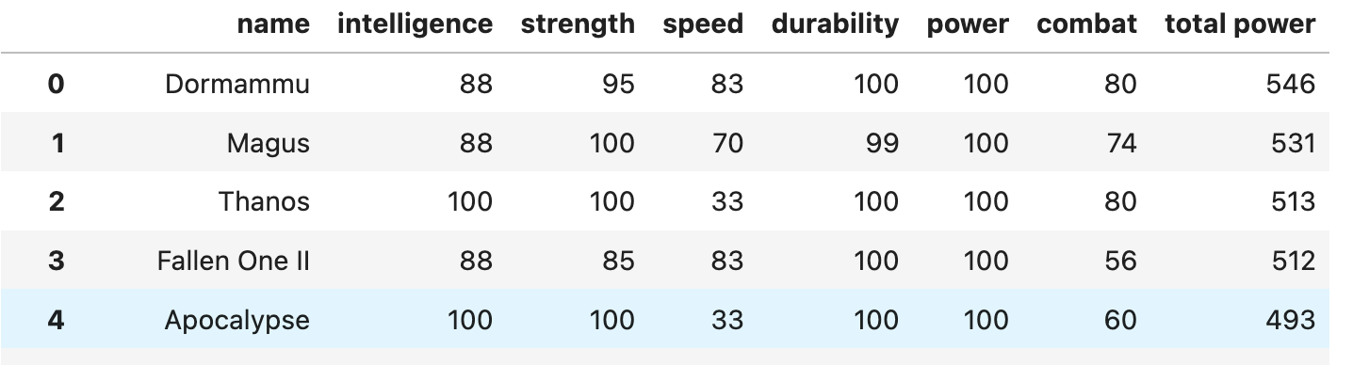
Most Powerful Villain (Marvel)

Slide 33

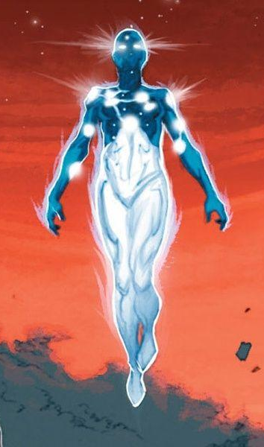
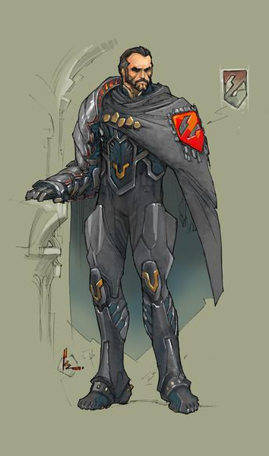
Strongest characters from both Universes

Slide 34
Reed:
Relations of hero/villain birthplaces
Birthplaces for both marvel and DC
Notes:
Nate

Slide 35


MARVEL : Birthplace Distribution

Slide 36


DC : Birthplace Distribution

Slide 37



Slide 38



Slide 39



Slide 40



Slide 41
What is the most common birthplace for Marvel and DC characters?
Marvel: New York City
12 heroes/ villains have their birthplace as New York City
DC: Gotham City
7 heroes/ villains have their birthplace as Gotham city

Slide 42
Kevin: Which Cinematic universe is more successful??

Slide 43


Top 10 Cinematic Universe Movies according to IMDB

Slide 44


Top 10 Cinematic Universe Movies according to Meta score

Slide 45




MARVEL vs DC : IMDB and Meta score

Slide 46




MARVEL vs DC : Gross earnings

Slide 47
Thanks !

